Slide 1
Community Driven Development and Social Networking
Becomes Pervasive
Seminar
“Thesis Outline“
Andreas Herglotz
18.01.2008

Slide 2
Agenda
Placement
Different Scenarios
Different Aspects (Ubiquitous Computing, Social Networking, Community Driven Development)
Architecture / Platform
Perspective
Opportunities and Challenges
CDD and Social Networking Becomes Pervasive - Andreas Herglotz

Slide 3
Placement
(Master Context)
Placement
Different Scenarios
Different Aspects:
- Ubi Comp
- Social Networking
- CDD
Architecture / Platform
Perspective
Opportunities and Challenges
AW1 – Theme (2nd Master term)
Pervasive Gaming (PG)
Project (3rd Master term)
Developing a PG-Framework plus Applications
AW2 – Theme (3rd Master term)
Clarification: What is CDD?
How / Where is CDD used?
Seminar – Theme (3rd Master term)
Coming next…
CDD and Social Networking Becomes Pervasive - Andreas Herglotz
Notes:
Und genaueres, was ich im Seminar mache folgt nun…

Slide 4
Base Scenario
(Community Messenger)
Placement
Different Scenarios
Different Aspects:
- Ubi Comp
- Social Networking
- CDD
Architecture / Platform
Perspective
Opportunities and Challenges
Interacting with buddies
Leaving your position to find you
Basics
Direct communication service
Location service
Server component
CDD and Social Networking Becomes Pervasive - Andreas Herglotz
Notes:
Vgl. MeetMe
Instant Messaging

Slide 5
Scenario (1)
(Exhibition - Indoor)
Placement
Different Scenarios
Different Aspects:
- Ubi Comp
- Social Networking
- CDD
Architecture / Platform
Perspective
Opportunities and Challenges
Finding the really interesting events with the help of the visitors
Describing and rating the exhibiting companies
Basics
Location service
Server component
News service
Description service
Rating service
CDD and Social Networking Becomes Pervasive - Andreas Herglotz
Notes:
Die letzen 3 sind neu
Description service – schön aber nicht notwendig.

Slide 6
Scenario (2)
(Flirt-Machine - Outdoor)
Placement
Different Scenarios
Different Aspects:
- Ubi Comp
- Social Networking
- CDD
Architecture / Platform
Perspective
Opportunities and Challenges
Everybody has an own and a search profile
Checking the position of the flirting people
If they are close to each other the profiles are getting compared if they match
Next steps: Creating a direct notification and if both accept the profile a direct connection
Basics
Direct communication service
Location service
Server component
News service
CDD and Social Networking Becomes Pervasive - Andreas Herglotz

Slide 7
Scenario (3)
(Reeperbahn - Hybrid)
Placement
Different Scenarios
Different Aspects:
- Ubi Comp
- Social Networking
- CDD
Architecture / Platform
Perspective
Opportunities and Challenges
Arriving at the Reeperbahn
Getting the tips of the day (clubs)
Getting the user recommendations
Getting the position of your buddies
Basics
Location service
Server component
Description service
Rating service
CDD and Social Networking Becomes Pervasive - Andreas Herglotz
Notes:
Wireless Accesspoint
Buddies können ihren Standort an den jeweiligen Club-Eingängen hinterlassen

Slide 8
Summary of the Scenarios
Placement
Different Scenarios
Different Aspects:
- Ubi Comp
- Social Networking
- CDD
Architecture / Platform
Perspective
Opportunities and Challenges
 | Exhibition | Flirt-Machine | Reeperbahn | Community Messenger
Indoor / Outdoor | Indoor | Outdoor | Hybrid | Hybrid
Location-Services | Bluetooth / WLAN / Barcodes | GPS | GPS / WLAN / Bluetooth / Barcodes | GPS / WLAN / Bluetooth / Barcodes
Communication Service | Nice to Have | Essential (Direct) | Nice to Have | Essential
Description + Rating Service for Locations | Essential | Nice to Have | Essential | Essential
News Service | Essential | Essential | Essential | Essential
Server Component | Essential | Essential | Essential | Essential
→ One Generic Community Messenger for various Scenarios
CDD and Social Networking Becomes Pervasive - Andreas Herglotz
- 7 -
Notes:
Letzte Spalte zeigt das, was der Community Messenger nachher als Grundlage zur Verfügung stellen soll.
Folie kurz abarbeiten…
Was diese Tabelle also zeigen soll, ist dass ich mir einen Community Messenger vorstelle. Der generisch für sehr viele Szenarien eingesetzt werden kann.
Kommen wir als nächstes zu drei informatikspezifischen Aspekten, die bei meiner Arbeit eine übergeordnete Rolle spielen.

Slide 9
Ubiquitous Computing
(Definition)
Placement
Different Scenarios
Different Aspects:
- Ubi Comp
- Social Networking
- CDD
Architecture / Platform
Perspective
Opportunities and Challenges
Many Computers serve each person
Opposite of virtual reality
Forces computer to live out here in the world with people
Difficult integration of human factors, computer science, engineering and social sciences
“The most profound technologies are those who disappear. They weave themselves into fabric of everyday life until they are indistinguishable from it.” (Mark Weiser)
CDD and Social Networking Becomes Pervasive - Andreas Herglotz
Notes:
Was ist UbiComp:
Viele Devices pro Mensch
Gegenteil zur Virtuellen Realität
Probleme:
Große Schwierigkeit dabei den Menschen, die angewandte Informatik, die technische Informatik und die
Sozialwissenschaften miteinander zu vereinigen.
- Ziel: Das verschwinden der technischen Geräte → der absolut natürliche Gebrauch (vgl. Handy)
In wiefern spielt das bei mir eine Rolle?

Slide 10
Ubiquitous Computing
(in context of my scenario)
Placement
Different Scenarios
Different Aspects:
- Ubi Comp
- Social Networking
- CDD
Architecture / Platform
Perspective
Opportunities and Challenges
All scenarios are realizable with a mobile device
This device could be a mobile phone, smart phone or PDA
Important is the natural use of these devices, because they are already integrated into everyday life
CDD and Social Networking Becomes Pervasive - Andreas Herglotz
Notes:
Natürlichen Gebrauch hervorheben.
(die Leistungsfähigkeit steigt ständig)

Slide 11
Social Networking
(Definition)
Placement
Different Scenarios
Different Aspects:
- Ubi Comp
- Social
Networking
- CDD
Architecture / Platform
Perspective
Opportunities and Challenges
One aspect of Web 2.0
Tools that allow people to come together
It consists of nodes and links which represents participants and their friendships
Different forms of social software:
Instant Massaging, online role-playing games, collaborative editing tools, …
CDD and Social Networking Becomes Pervasive - Andreas Herglotz

Slide 12
Social Networking
(in context of my scenario)
Placement
Different Scenarios
Different Aspects:
- Ubi Comp
- Social
Networking
- CDD
Architecture / Platform
Perspective
Opportunities and Challenges
Up to now in most cases social networking happened just in front of a desktop pc
Bridging to the real life – now user can use this network wherever they are and whenever they want
CDD and Social Networking Becomes Pervasive - Andreas Herglotz

Slide 13
CCD - Content
(Definition)
Placement
Different Scenarios
Different Aspects:
- Ubi Comp
- Social Networking
- CDD
Architecture / Platform
Perspective
Opportunities and Challenges
The community creates the content for itself
Know How
From wizards for wizards (Linux, Mozilla)
From wizards for everybody (Wikipedia)
From everybody for everybody (Second Life)
User Interface
Wizards
Programmers
Authors
CDD and Social Networking Becomes Pervasive - Andreas Herglotz

Slide 14
CCD - Content
(in context of my scenario)
Placement
Different Scenarios
Different Aspects:
- Ubi Comp
- Social Networking
- CDD
Architecture / Platform
Perspective
Opportunities and Challenges
Every user has the possibility to create content wherever he is and whenever he want
Different kinds of content
Describing locations
Rating locations
Important aspects
License of the content
Copyright
Administration
CDD and Social Networking Becomes Pervasive - Andreas Herglotz
Notes:
CDD – Networking
Using Android it is also an opportunity that user create new parts of the messenger or simply change parts and create new components nobody thought about yet

Slide 15
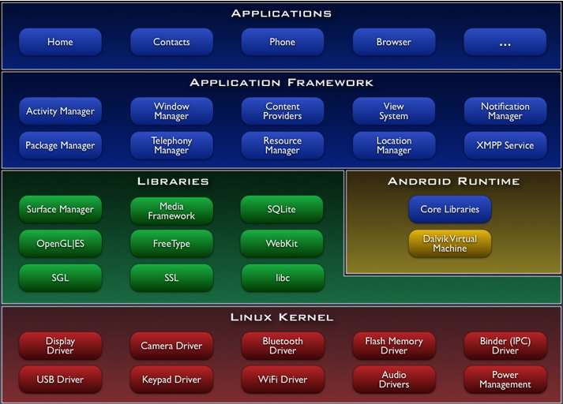
Architecture
(Android)
Placement
Different Scenarios
Different Aspects:
- Ubi Comp
- Social Networking
- CDD
Architecture / Platform
Perspective
Opportunities and Challenges
CDD and Social Networking Becomes Pervasive - Andreas Herglotz

Slide 16
Architecture
(Client – Exhibition)
Placement
Different Scenarios
Different Aspects:
- Ubi Comp
- Social Networking
- CDD
Architecture / Platform
Perspective
Opportunities and Challenges
Community Messenger
CDD and Social Networking Becomes Pervasive - Andreas Herglotz

Slide 17
Architecture
(Client – Flirt-Machine)
Placement
Different Scenarios
Different Aspects:
- Ubi Comp
- Social Networking
- CDD
Architecture / Platform
Perspective
Opportunities and Challenges
Community Messenger
CDD and Social Networking Becomes Pervasive - Andreas Herglotz

Slide 18
Architecture
(Client – Reeperbahn)
Placement
Different Scenarios
Different Aspects:
- Ubi Comp
- Social Networking
- CDD
Architecture / Platform
Perspective
Opportunities and Challenges
Community Messenger
CDD and Social Networking Becomes Pervasive - Andreas Herglotz

Slide 19
Architecture
(Client – Community Messenger)
Placement
Different Scenarios
Different Aspects:
- Ubi Comp
- Social Networking
- CDD
Architecture / Platform
Perspective
Opportunities and Challenges
Community Messenger
CDD and Social Networking Becomes Pervasive - Andreas Herglotz

Slide 20
Android
(Platform – Client)
Placement
Different Scenarios
Different Aspects:
- Ubi Comp
- Social Networking
- CDD
Architecture / Platform
Perspective
Opportunities and Challenges
Location Manager
Uses the location service which is available to find friends or buildings
XMPP
Sends device to device - data to other users
Notification Manager
Tells the user that something in the background has happened
SQLite
Small Database for the mobile device
Activity Manager
Manages the lifecycle of the applications
CDD and Social Networking Becomes Pervasive - Andreas Herglotz

Slide 21
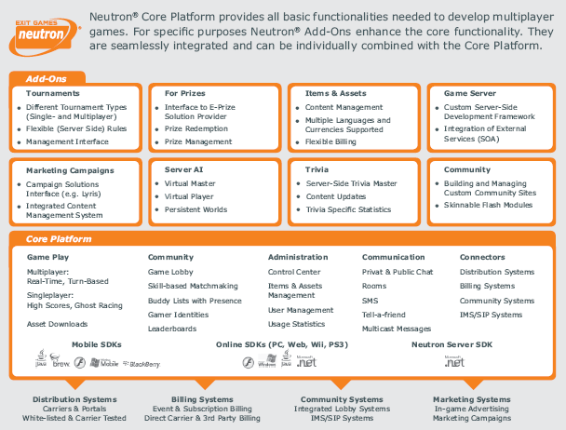
Neutron
(Platform – Server)
Placement
Different Scenarios
Different Aspects:
- Ubi Comp
- Social Networking
- CDD
Architecture / Platform
Perspective
Opportunities and Challenges
CDD and Social Networking Becomes Pervasive - Andreas Herglotz
Notes:
Not my focus:
Developing every component from scratch
Target:
Using services and reusing components from Android
Using server infrastructure and framework Neutron from Exit Games

Slide 22
Perspective
Placement
Different Scenarios
Different Aspects:
- Ubi Comp
- Social Networking
- CDD
Architecture / Platform
Perspective
Opportunities and Challenges
My Vision: One Messenger
Usable anytime and anyplace –
a natural unobtrusive mobile phone (Pervasive)
Creating content whenever you want and wherever you are (Community Driven Development)
Making the step from the virtual community to the real life (Social Networking)
Using a completely new platform (Android)
Android Developer Challenge
CDD and Social Networking Becomes Pervasive - Andreas Herglotz

Slide 23
Opportunities
and Challenges
Placement
Different Scenarios
Different Aspects:
- Ubi Comp
- Social Networking
- CDD
Architecture / Platform
Perspective
Opportunities and Challenges
Opportunities
Creating something completely new
Transport CDD in a pervasive context
Bridge from virtual social networking to real life social networking
Using a new platform (Android)
Challenges
Creating something completely new
Using an SDK in a non-final version
Using an emulator – because the hardware still does not exist
CDD and Social Networking Becomes Pervasive - Andreas Herglotz

Slide 24
References
Exit Games; Mobile Social Software – Applications that Drive Social Networking and Maximize Your Revenues (May 2006)
O‘Reilly; What is Web 2.0; (30.05.2005)
http://www.ubiq.com/hypertext/weiser/UbiHome.html (17.01.2008)
Mark Weiser; The Computer for the Twenty-First Century; Scientific American pp.94-100 (September 1991)
Howard Stearns, Joshua Gargus, et al.; Simplified Distributed Authoring Via Component-based Object Construction and Deconstruction in Collaborative Croquet Spaces; (05.2006) – IEEE
Michele Tapper; The Rise of Social Software (September 2003) - ACM
Hirokazu Tomiyazu, et al.; Social Network Applications Using Cellular Phones with Email Function; (2005) – IEEE
CDD and Social Networking Becomes Pervasive - Andreas Herglotz
- 23 -

Slide 25
Thanks – Any Questions?
CDD and Social Networking Becomes Pervasive - Andreas Herglotz
- 24 -

